Slide 1

Chef configuration management tool
By:
Ali Mehrani
Ali Ranjbari
Amirreza ghahremani

Slide 2
topics
Introduction
What is Chef?
Configuration management in Chef
Why Chef?
Architecture and components of Chef

Slide 3
introduction
Permanent demands for deploying software services in organizations.
Deployment is a tedious and sensitive task, especially for large organizations.
Chef enables infrastructure management.
We’ll start with an example.

Slide 4
AN EXAMPLE
Consider a system administrator maintaining multiple systems in a network.
System failures can occur frequently.
A single system admin can manage individual system failures.
Multiple simultaneous issues are hard to handle.

Slide 5
AN EXAMPLE
Risk of severe network disruptions.
Can be resolved by synchronizing environments and automating processes.
Chef makes this easy.

Slide 6
What is Chef?
An open-source configuration management tool
Uses Ruby to develop essential building blocks like recipes and cookbooks.
Converts infrastructure to code as an automation tool.

Slide 7
What is Chef?
writing code instead of using the manual process.
Manage and config multiple systems.
Continuous test and deployment.

Slide 8
What is Chef?
Chef supports various cloud computing platforms including:
AWS
Google Cloud Platform
OpenStack
SoftLayer (IBM cloud)

Slide 9
Configuration Management in Chef
Consider yourself as the company’s system administrator
Have to update the software on numerous systems.
Better not to do that manually!
Getting back to the previous state if system is crashed during update?
Savior configuration management helps here.

Slide 10
Configuration Management in Chef
Configuration Management:
keeps all the info about the system's hardware, software, and infrastructure.
Helps managing complex infrastructures.
Automates time-consuming tasks.

Slide 11
Configuration Management in Chef
Enables automated deployments to restore services of a server
Automatically handles changes in the infrastructure
A big help in unwanted disasters!

Slide 12
Why Chef?
A DevOps tool that helps in:
Automating the process of infrastructure provisioning.
Speeding up the deployment process and software delivery.
Simplifying the configuration task.

Slide 13
Why Chef?
Managing the system's server.
Configure, deploy and manage the entire application infrastructure.
Next, we will mention some of its popular features.

Slide 14
Why chef?
Chef can easily manage a large number of servers with fewer employees.
Allows continuity in the deployment process from building to the end.
Can be managed using different Operating Systems like Linux, and Windows.
Can be integrated with several major cloud service providers.

Slide 15
Why chef?
A single chef-server may be used as a center for all policy deployment.
Chef is a reliable and stable tool for large deployments.
Helps in managing the risk at all stages of deployment.

Slide 16
Architecture and Components of Chef
The architecture of Chef can be divided into three components:
Workstation
Chef Server
Nodes

Slide 17
Workstation
Simply, the admin’s system.
Makes possible interactions with Chef-nodes and Chef-server.
Cookbooks are created, tested, and deployed here.
Other Chef users cookbooks can also be downloaded using the workstation.

Slide 18
Workstation Components
Development Kit
Chef-Repo
Knife
Test Kitchen

Slide 19
Workstation Components
Development Kit:
Contains numerous packages
Contained packages are required for using Chef.

Slide 20
Workstation Components
Chef-Repo
A directory of the workstation where all the cookbooks are maintained.
Can be created using this command: “chef to generate repo repo-name”.

Slide 21
Workstation Components
Knife
Provides a communication interface.
Communication between a local chef-repo and chef server
Helps managing Nodes, Cookbooks, and Recipes.

Slide 22
Workstation Components
Test Kitchen
Provides a development environment to the workstation
Enables it to create and test workbooks before they are distributed.

Slide 23
Chef Server
Chef Server is the center of the workstation and the nodes.
All the cookbooks, recipes, and metadata are stored here.
The workstation sends the cookbook to the server using a knife.

Slide 24
Chef Server
The nodes communicate with the server using the Chef client.
Any changes made to the infrastructure code, must be passed to the Chef Server.
Chef Server applies the changes to the nodes.

Slide 25
Nodes
Nodes refer to the machines that are managed or configured by the Chef-Server.
Might be virtual servers, network devices, or storage devices.
Chef client executes the steps needed to bring the node into the required state

Slide 26
Nodes
Steps are defined by a cookbook.
Chef client makes it possible for the nodes to stay up to.
Chef client runs individually on each node to configure them.

Slide 27
A code Sample
A simple code sample in chef for the following concern:
Installing Nginx on the server.
Ensuring Nginx is enabled to start at boot.
Template file for defining Nginx server configuration.

Slide 28
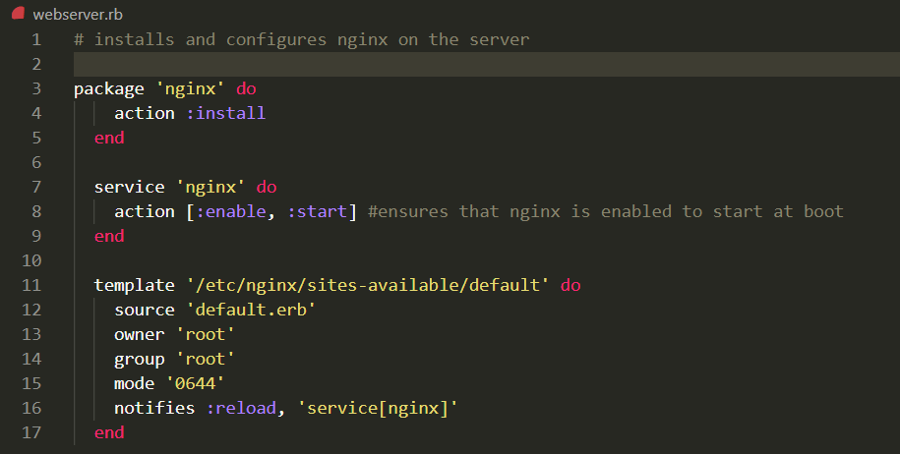
A code Sample

Slide 29
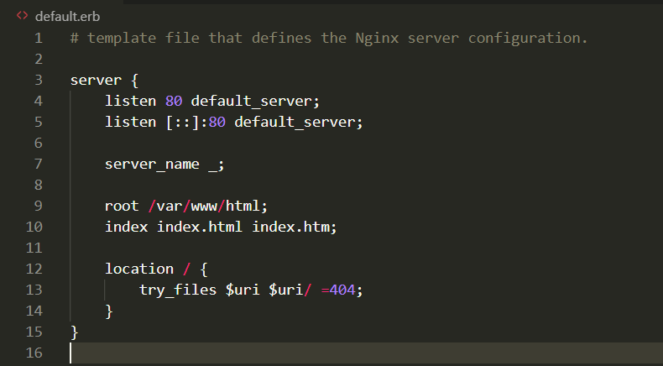
A code Sample

Slide 30
Thank You for your attention!

